Slide 1

Continuous Ketone Monitoring (CKM) for Patients with Diabetes:
What Practitioners Need to Know
Steven V. Edelman, MD
Clinical Professor of Medicine,
University of California San Diego;
Veterans Affairs Medical Center;
Founder and Director,
Taking Control Of Your Diabetes, 501(c)3
Jeremy Pettus, MD
Associate Professor of Medicine,
University of California San Diego;
Director, Type 1 Initiatives,
Creative Productions,
Taking Control Of Your Diabetes, 501(c)3

Slide 2
Introduction to CKM
Why it is Important for Diabetes Management
Learning Objectives:
  Describe the current prevalence and clinical impact of diabetic ketoacidosis (DKA) in individuals with diabetes.
  Identify key risk factors, early warning signs, and symptoms associated with DKA.
  Evaluate the effectiveness and limitations of current DKA detection methods.
  Explain the clinical benefits and functionality of CKM (Continuous Ketone Monitoring) devices.
  Demonstrate strategies for patient education and integration of CKM technology into clinical practice.

Slide 3
VIDEO:
Patient going to emergency room with unknown cause of DKA

Slide 4
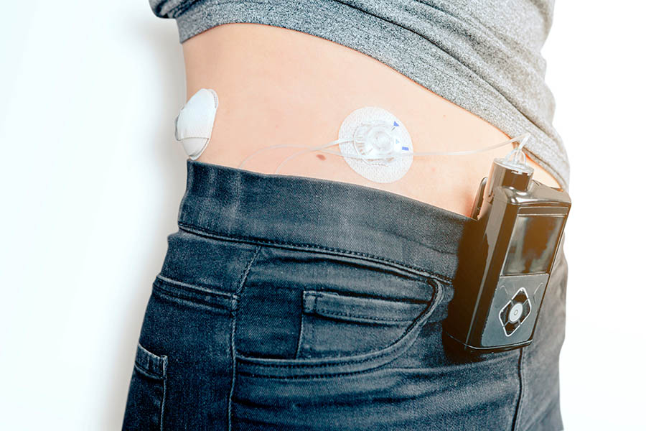
Case Presentation:
Susie is a 47-year-old woman living with type 1 diabetes for 30 years.
Susie wears an HCL/AID system with a long history of excellent control (i.e. A1c, TIR, TBR and glycemic variability)
She presents to the ED with several hours of nausea, vomiting, muscle aches and flu-like symptoms.
Susie’s glucose level was 210 mg/dl and an anion Gap of 22 and was admitted to the ICU for DKA
She was recently put on a SGLT 2 inhibitor for a rising UA/CR value into the abnormal range.

Slide 5
Case Presentation (cont.):
Susie is a 47-year-old woman living with type 1 diabetes for 30 years.
Discussion Between Doctors - What could have caused her DKA?
She was recently put on a SGLT 2 inhibitor for a rising UA/CR value into the abnormal range (euglycemic DKA which explains her lowish glucose level. Most episodes of DKA present with very high glucose levels.
Pump infusion line pulling out leaving her without insulin for hours (common cause of DKA low or no insulin)
Susie got sick with a flu and und did not give herself insulin as she thought “since she was not eating, she did not give insulin” In fact she needed more than usual insulin even when not eating (basic sick day rules every PWD should know)

Slide 6
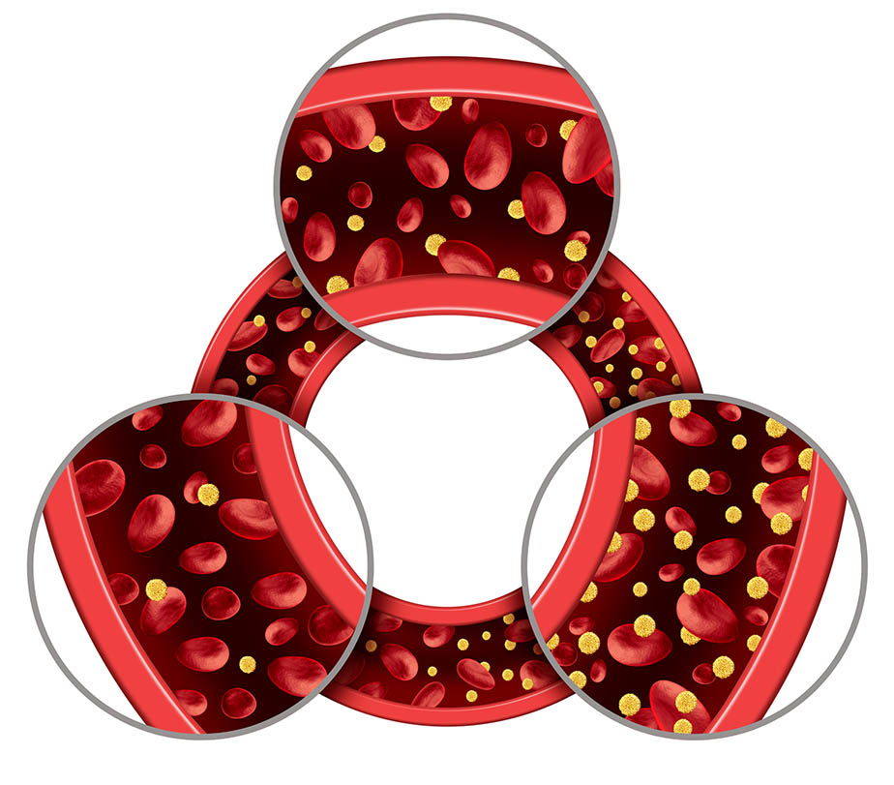
Definition of DKA
Diabetic ketoacidosis (DKA) is a serious, life-threatening complication of diabetes characterized by hyperglycemia, Ketonuria, and ketoacidosis.
It primarily affects individuals with type 1 diabetes due to an absolute insulin deficiency but can also occur in type 2 diabetes.
Glaser N, et al. ISPAD clinical practice consensus guidelines 2022: Diabetic ketoacidosis and hyperglycemic hyperosmolar state. Pediatr Diabetes. 2022 Nov;23(7):835-856

Slide 7
Euglycemic DKA
has been recognized for decades before SGLT inhibitors
What is Euglycemia DKA? presence of all the features of DKA but with a glucose level as low as 200mg/dl (normally higher in DKA).
Euglycemic DKA commonly occurs in patients with a history of low glucose states such as starvation, chronic liver disease, pregnancy, infection, and alcohol use. SGLT inhibitors, which result in increased urinary glucose excretion, are also associated with EDKA
Same Symptoms
– Approximately 2.6% to 3.2% of DKA admissions are euglycemic –
American Diabetes Association Professional Practice Committee; 6. Glycemic Goals and Hypoglycemia: Standards of Care in Diabetes—2025. Diabetes Care 1 January 2025; 48 (Supplement_1): S128–S145

Slide 8
Pathophysiology of DKA
Insulin Deficiency
Typically with Hyperglycemia (euglycemic DKA)
Fat Breakdown (Lipolysis), ketone production and DKA
Osmotic diuresis (dehydration)
Electrolyte Imbalance (loss of sodium, potassium etc.)
Glaser N, et al. ISPAD clinical practice consensus guidelines 2022: Diabetic ketoacidosis and hyperglycemic hyperosmolar state. Pediatr Diabetes. 2022 Nov; 23(7):835-856
Notes:
1. Insulin Deficiency:
The fundamental issue in DKA is a lack of insulin, which is crucial for allowing glucose to enter cells for energy.
2. Hyperglycemia:
Without sufficient insulin, glucose accumulates in the bloodstream, leading to hyperglycemia (Will discuss euglycemic DKA later).
3. Fat Breakdown (Lipolysis):
In response to the perceived energy shortage, the brain sends signals to break down fats for fuel, a process called lipolysis.
4. Ketone Production:
The breakdown of fat results in the production of ketone bodies (primarily beta-hydroxybutyrate or BHB).
5. Ketoacidosis:
The buildup of ketones in the blood leads to a state of acidosis, as ketones are acidic (pH starts to drop to dangerous levels)
6. Osmotic Diuresis
The high blood glucose levels cause an osmotic diuresis, meaning the kidneys excrete excess glucose and water into the urine, leading to dehydration. Nausea and vomiting makes matters worst.
7. Electrolyte Imbalance:
The osmotic diuresis can also cause electrolyte imbalances, such as loss of sodium, potassium, and other electrolytes.

Slide 9
Prevalence of Diabetic Ketoacidosis
Type 1 Diabetes:
46% present at diagnosis of diabetes with DKA, 5-8% per year
Type 2 Diabetes:
Less common in type 2 diabetes,1.5% per year
Age and DKA:
More prevalent among children and adolescents
Racial and Ethnic Disparities:
Primarily caucasian, but can occur in any ethnic group
Mortality:
Higher with the elderly, underserved, multisystem disease, etc.
Virdi N, Poon Y, Abaniel R, Bergenstal RM. Prevalence, Cost, and Burden of Diabetic Ketoacidosis. Diabetes Technol Ther. 2023 Jun;25(S3):S75-S84.
Notes:
Type 1 Diabetes:
DKA is a common complication of type 1 diabetes, with studies showing a prevalence of DKA at diagnosis ranging from 25% to 46.7%.
Type 2 Diabetes:
While DKA is less common in type 2 diabetes, it can still occur, particularly at the time of diagnosis.
Trends in DKA Prevalence:
Studies have shown an increase in the prevalence of DKA at or near diabetes diagnosis, particularly among those with type 1 diabetes. Estimates range from 5% to 8% per year.
Age and DKA: more prevalent among children and adolescents with T2D
Racial and Ethnic Disparities: Primarily Caucasian but can occur in any ethnic group
Mortality:
While in-hospital case-fatality rates for DKA have declined, DKA remains a significant concern, particularly in vulnerable populations such as the elderly or those with other serious illnesses.

Slide 10
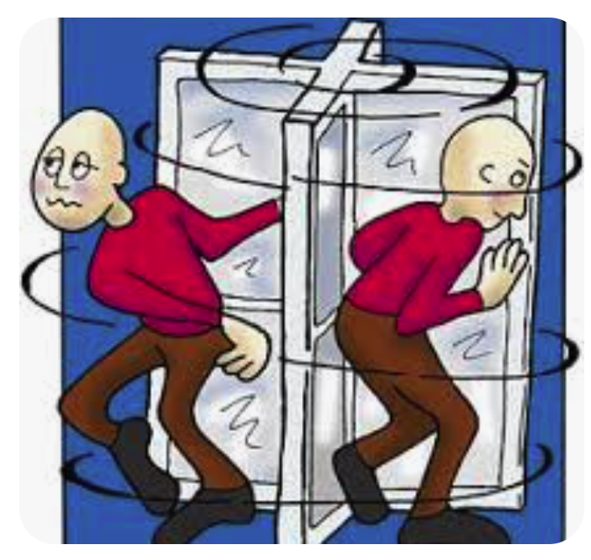
Causes and risk factors for dka
Missed insulin doses
Insulin pump infusion lines dislodged unknowingly
Illness, infections, and stress (not implementing sick day rules)
Use of SGLT inhibitors (euglycemic DKA)
Knowledge gaps in patient and provider education
Elevated A1c over 9% and “revolving door phenomenon”
American Diabetes Association Professional Practice Committee; 6. Glycemic Goals and Hypoglycemia: Standards of Care in Diabetes—2025. Diabetes Care 1 January 2025; 48 (Supplement_1): S128–S145
Ngan J, et al. Revisiting the benefits vs risk profile of sodium-glucose co-transporter inhibitor use in type 1 diabetes. Part B: Risks of sodium-glucose co-transporter inhibitor use in type 1 diabetes and ketoacidosis risk mitigation strategies. Diabetes Res Clin Pract. 2025 May 27;226:112284.
Notes:
Heart attack, stroke or other severe medical illness
Physical injury, such as from a car accident
Excessive alcohol or drug use
Certain medications, such as some diuretics, corticosteroids, atypical antipsychotics, chemotherapy and SGLT inhibitors

Slide 11
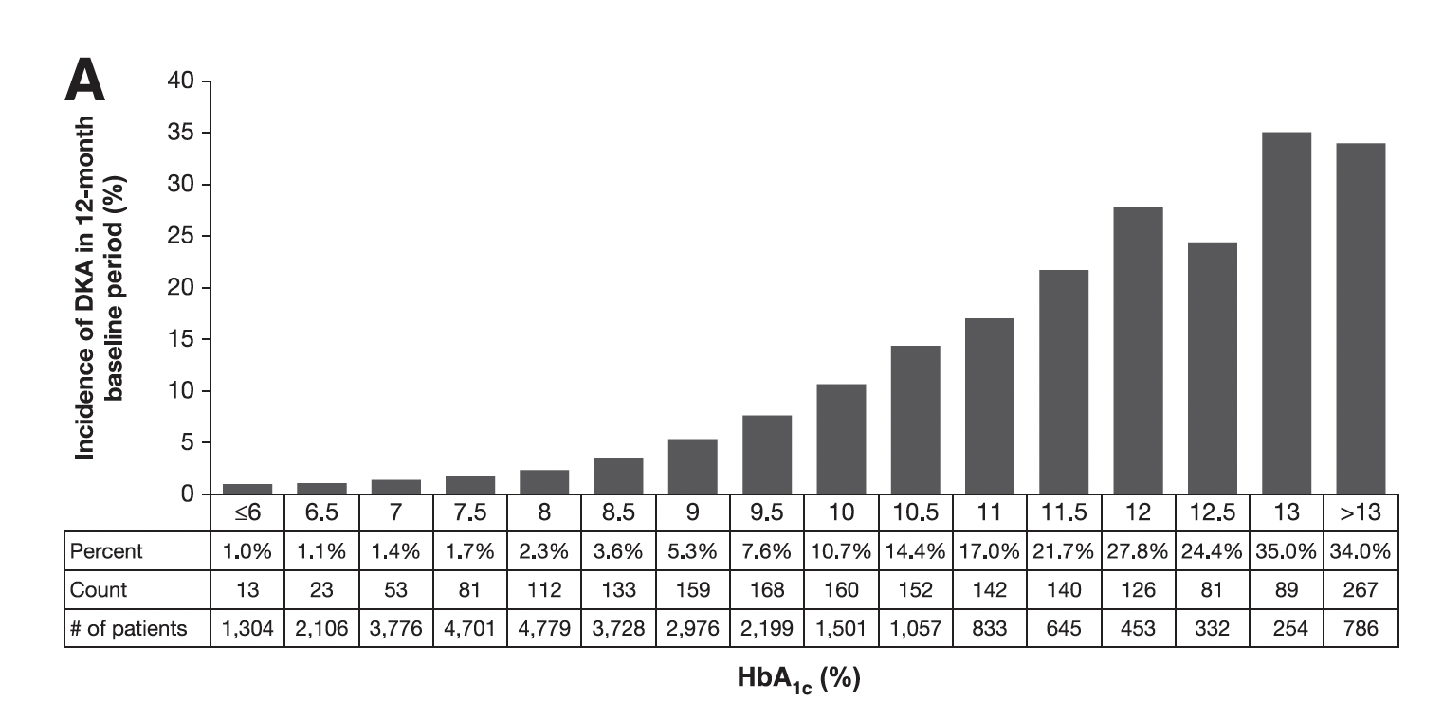
Patients with elevated A1c levels are at a much higher risk for DKA
12-fold increase in DKA going from an A1c of 8.0 to 11.5%

Slide 12
– Very different than a high glucose from overeating –
Early recognition is important!
Signs and Symptoms of DKA
Early “Flu-like” Symptoms
Excessive thirst, frequent urination, high blood sugar levels, dry mouth, fatigue, elevated levels of ketones in the urine/blood
Severe “Flu-like” Symptoms
Abdominal pain, nausea, vomiting, muscle aches, headache, confusion, rapid beathing, dry skin and mouth and fruity-smelling breath
- BG 400 mg/dl
- No ketones
- BG 400 mg/dl
- Large ketones
Notes:
Severe symptoms: Unconsciousness, coma and death

Slide 13
VIDEO:
Demonstrating the difference between measuring BHB in the blood VS acetoacetate in urine
Beta Hydroxybutyrate or BHB is the
primary ketone present in DKA
BHB at the current time must be measured in the blood (laboratory or fingerstick device)
Acetoacetate can be measured in the urine but is not reliable to diagnose or follow the course of DKA
BHB rises BEFORE the glucose values in DKA when the patient is asymptomatic (hence importance of CKM)
Marks BE, et al. Ketone Management in Pediatric Diabetes Centers in the USA: Current Practices and a Call for Improved Standardization. Horm Res Paediatr. 2024 Oct 15:1-9

Slide 14
Current DKA Detection Methods &
Limitations of Testing For Ketones
Urine Ketone Testing (measures acetoacetate):
  Delayed results, false positives, not real-time
  Patients do not use them consistently
Fingerstick Blood Ketone Testing (BHB levels):
  Testing strip expense, limited shelf life, low rate of self-monitoring by patients if prescribed at all by HCPs
  Lack of understanding among patients and HCPs about interpretation and response
  Rarely prescribed
Albanese-O'Neill A, et al. T1D Exchange Clinic Network. Poor Adherence to Ketone Testing in Patients With Type 1 Diabetes. Diabetes Care. 2017 Apr;40(4):e38-e39

Slide 15
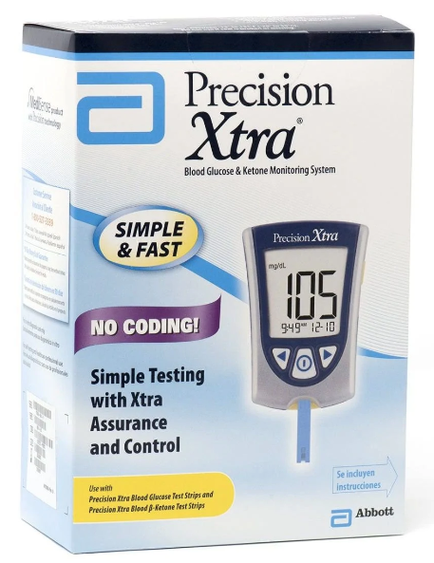
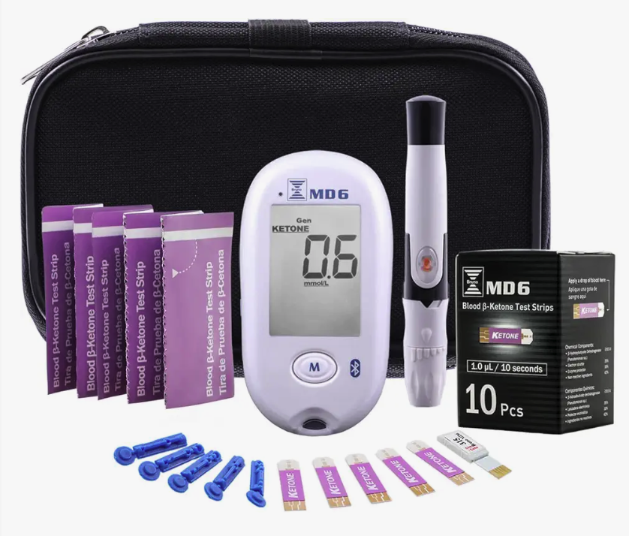
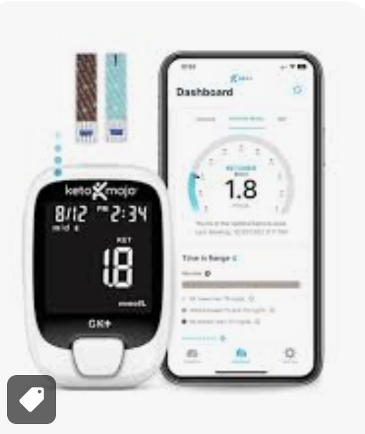
MEASURING BHB WITH A FINGERSTICK
We currently have numerous accurate ketone monitors on the market that measure both beta hydroxybutyrate (BHB) and glucose using different strips.
The problem is that it requires a separate device to carry, ketones strips and does not give continuous readings
Notes:
Most dotors do not prescribe them

Slide 16
Introduction to Continuous Ketone Monitoring (CKM)
What is CKM?
  Similar to CGM but measures BHB (from the same sensor)
  Provides real-time data, trend arrows and alerts for elevated levels
  and rising ketones
  Remote monitoring by caregivers and HCPs
Benefits:
  Prevention of DKA through early detection and timely intervention
  Opportunity for home treatment
  Reduced or eliminate ER visits and hospitalizations

Slide 17
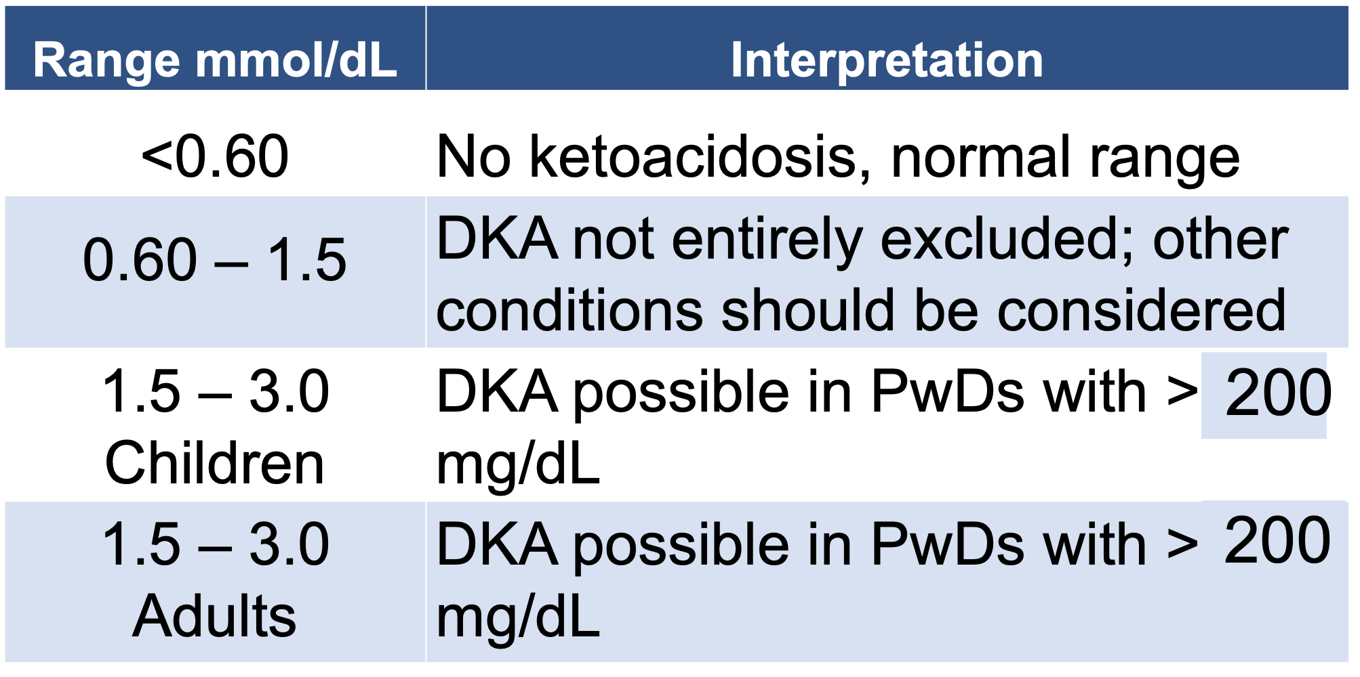

How many of YOU who are viewing this CME program
know what the normal and abnormal levels of BHB are?

Slide 18
BHB Levels and When to be Concerned
Most providers and PWD are not familiar with normal, worrisome and critical BHB levels
– CKM devices will have alerts and trending notifications –
Normal: < 0.6 mmol/L.
Mild Ketosis: 0.6 - 1.5 mmol/L
(may warrant insulin adjustment).
Moderate Ketosis: 1.5 - 3.0 mmol/L (requires medical intervention and carries a risk of progressing to DKA).
Consistent with DKA: > 3.0 mmol/L.
Severe DKA: > 6 mmol/L.
BG >200mh/dl
American Diabetes Association Professional Practice Committee; 6. Glycemic Goals and Hypoglycemia: Standards of Care in Diabetes—2025. Diabetes Care 1 January 2025; 48 (Supplement_1): S128–S145

Slide 19
VIDEO:
Patient experiencing DKA at amusement park

Slide 20
STICH Protocol
STop the SGLT inhibitor if on one
Insulin administration (give via a syringe if on a pump).
Will need larger than normal doses (glucose toxicity)
Carbohydrate intake (~30 to 60 grams) Supplies fuel to the brain
and cuts off the drive to produce ketones (brain uses ketones as
an energy source in DKA)
Hydrate (something with electrolytes like Gatorade or similar)
+ Frequent monitoring (glucose and ketones)
https://beyondtype1.org/stitch-protocol-for-dka-management/

Slide 21
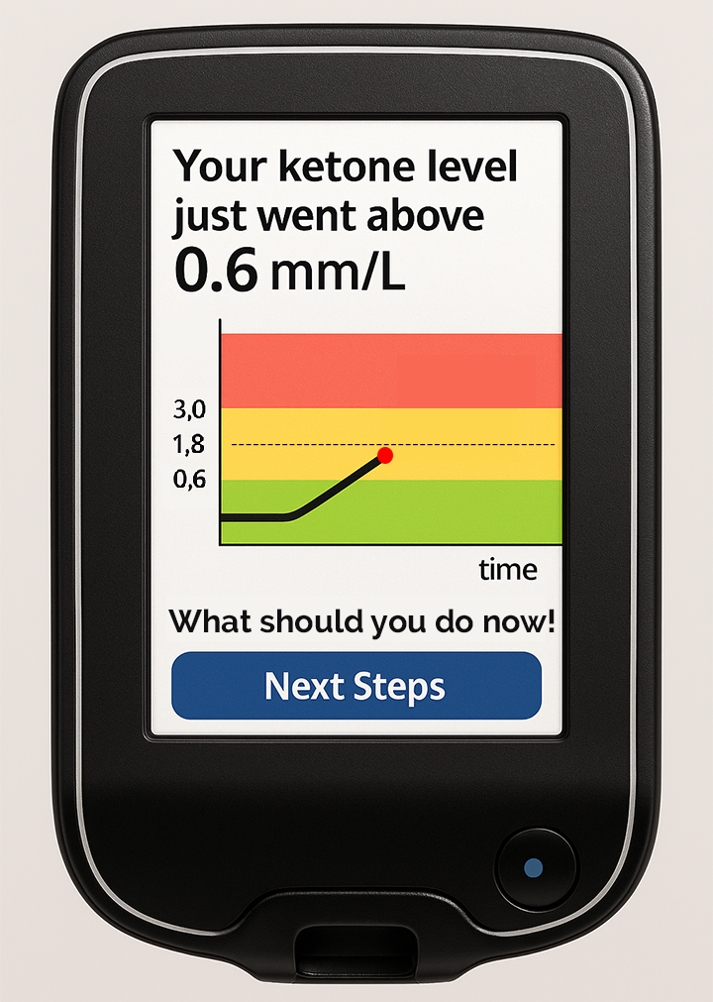
What Could a CKM Look Like?
Alerts user when BHB gets above o.6
Potential to customize the alert levels
Color coded for simplicity
Next Steps button to have specific recommendations to mitigate the progression to DKA
Information such as Insulin, fluids, carbohydrates and close monitoring suggestions
Numbers of HCP, ER, caregiver, and 24 hour STOP DKA hot line, etc.
Kong YW, et al. Continuous ketone monitoring: Exciting implications for clinical practice. Diabetes Obes Metab. 2024 Dec;26 Suppl 7(Suppl 7):47-58

Slide 22

Once approved and in use we will learn about ketones in the free-living state in people with any type of diabetes (T1D, T2D and gestational diabetes)
A Continuous Ketone Monitor Could Have These Extra Features
15-day wear (Libre 3+)/pump integration
Remote monitoring
Auto inserter
Bluetooth with phone app
Apple Watch connectivity
EPIC/EMR Integration
Factory calibrated
Kong YW, et al. Continuous ketone monitoring: Exciting implications for clinical practice. Diabetes Obes Metab. 2024 Dec;26 Suppl 7(Suppl 7):47-58

Slide 23

CLINICAL IMPLICATIONS OF CKM
Impact on Clinical Flow:
  How to integrate CKM into HCP workflow
  (not different than for CGM)
  Managing patient alerts, calls, and follow-ups
On-Call Responsibilities:
  Addressing urgent ketone alerts
  Remote-monitoring and telehealth applications

Slide 24
Future Directions and Adoption of CKM
Lessons from CGM adoption for accelerating CKM acceptance
Addressing barriers: Cost, insurance coverage, patient clinician training/education
Potential for automated insulin delivery (AID) integration
Potential for inpatient
Anticipated timeline for Abbott’s first CGM/CKM device

Slide 25
Target Populations: Who is most at risk?
  Patients with type 1 diabetes, but also a subset of type 2 diabetes
  T1D/T2D on SGLT inhibitors
  Women with diabetes who are pregnant
  Any person with T1D and an eating disorder
  People who are socially or geographically isolated
  People who consume alcohol excessively
  Tracking beta cell failure (LADA, stage 2 T1D, etc.)
  People with recurrent DKA

Slide 26

Conclusion & Key Takeaways
DKA remains a major risk for people with diabetes
Current ketone monitoring methods have limitations
CKM provides real-time ketone data
for early detection and proactive intervention of DKA
Education for HCPs & patients is
critical for successful adoption

Slide 27

Q&A AND RESOURCES
Q&A Session
Additional Resources
  TCOYD Website: tcoyd.org
  ADCES Website: adces.org
  Patient education video on DKA: WATCH HERE
  Patient education podcast on DKA: LISTEN HERE

Slide 28

Dr. Jeremy Pettus
Email: jpettus@health.ucsd.edu
Dr. Steven Edelman
Email: steve@tcoyd.org
Follow TCOYD for updates on CKM and diabetes technology!

